Slide 1



RESEARCH GRANT PROPOSAL
Presented By:
PROFESSOR KANU IKECHUKWU ANTHONY (O.S.A)
Department of Philosophy and Religious Studies
Tansian University, Nigeria
@TORMP 2020 International Training on Research Manuscript Drafting and Publishing, Eudoxia Research Centre, India
MAY 16, 2020

Slide 2

PRESENTATION OUTLINE
1
Introduction
What is a Research Grant Proposal?
2
3
Initial Steps
Major Parts
4
4
Conclusion
5
5
Chart 1

Slide 3
1
Introduction
1
Introduction
Chart 2

Slide 4
INTRODUCTION
One of the ways through which nations, government agencies and private establishments have grown is through sponsoring of research:
While the proceeds of research adds value to national development, agencies and companies put more money into research.
Reasearch
Nations, Agencies and Private Companies
Chart 3

Slide 5

From: Dunn A. (2017)
This could remind us of facts:
Major scientific discoveries were possible because of the generosity of funding agencies
The funds are not easy to come by. It doesn’t mean that once you write you get the funds.
Chart 4

Slide 6
What is a Research Grant Proposal?
1
Introduction
2
Chart 5

Slide 7
WHAT IS A RESEARCH GRANT PROPOSAL?
It is “A formal proposal submitted to a government or civilian entity that outlines a proposed project and shows budgetary requirements and requests monetary assistance in the form of a grant” (Enterpreneur 2018)
It is a social investment
It is for the enhancement of social change
It is a partnership to help achieve aims and objectives
It is a means for accomplishing mission
It is a proposal not a grant yet
Chart 6

Slide 8
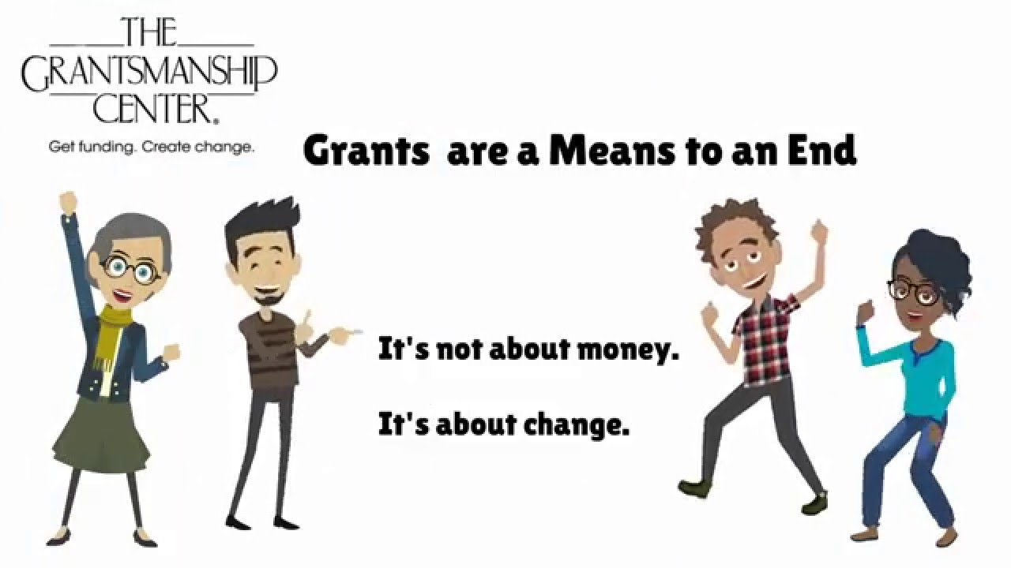
Chart 7

Slide 9
1
Introduction
3
Initial Steps
Chart 8

Slide 10

INITIAL STEPS
Agree on a Problem
Define It
Describe its impact
Describe its causes
Describe what you hope to achieve
Describe the outputs and outcomes
Chart 9

Slide 11
INITIAL STEPS CONTINUED………
Design your programme
Get expert opinion
See what others have done
What solution are bringing in
Locate funding sources
Government
Individual
Organizations
Write your proposal
Chart 10

Slide 12
1
Introduction
4
Major Parts
Chart 11

Slide 13
PARTS OF A RESEARCH GRANT PROPOSAL
Cover letter
Title page
Executive Summary
4. Background
5. Statement of need
6. Goals and Objectives
Chart 12

Slide 14
PARTS OF A RESEARCH GRANT PROPOSAL CONTINUED......
7. Expected Results
8. Methodology and Strategy
9. Evaluation/Measurement of Success of Event
10. Project Timeline
11. Project Budget
Chart 13

Slide 15
1
Introduction
5
Conclusion
Chart 14

Slide 16


Conclusion
Chart 15

Slide 17
References
ARC (2018). How to write a grant proposal. Retrieved from https://www.arc.gov/funding/HowtoWriteaGrantProposal.asp
Enterpreneur (2018). Grant Proposal. Retrieved from https://www.entrepreneur.com/encyclopedia/grant-proposals
Peggy Downs (2020). Five steps to develop a grant proposal for your school. https://www.peggydowns.com/post/grant-proposal
Dunn A. (2017). Proposal writing- A perspective from a programme Officer. https://curchem.wordpress.com/2017/09/04/proposal-writing-a-perspective-from-a-program-officer/
Chart 16

